Slide 1
Students will be able to:
Learn about the bodies response to infection.
I understand that infectious diseases caused by invasion of pathogens in the form of visues and bacteria can be transmitted from one host to another.

Slide 2
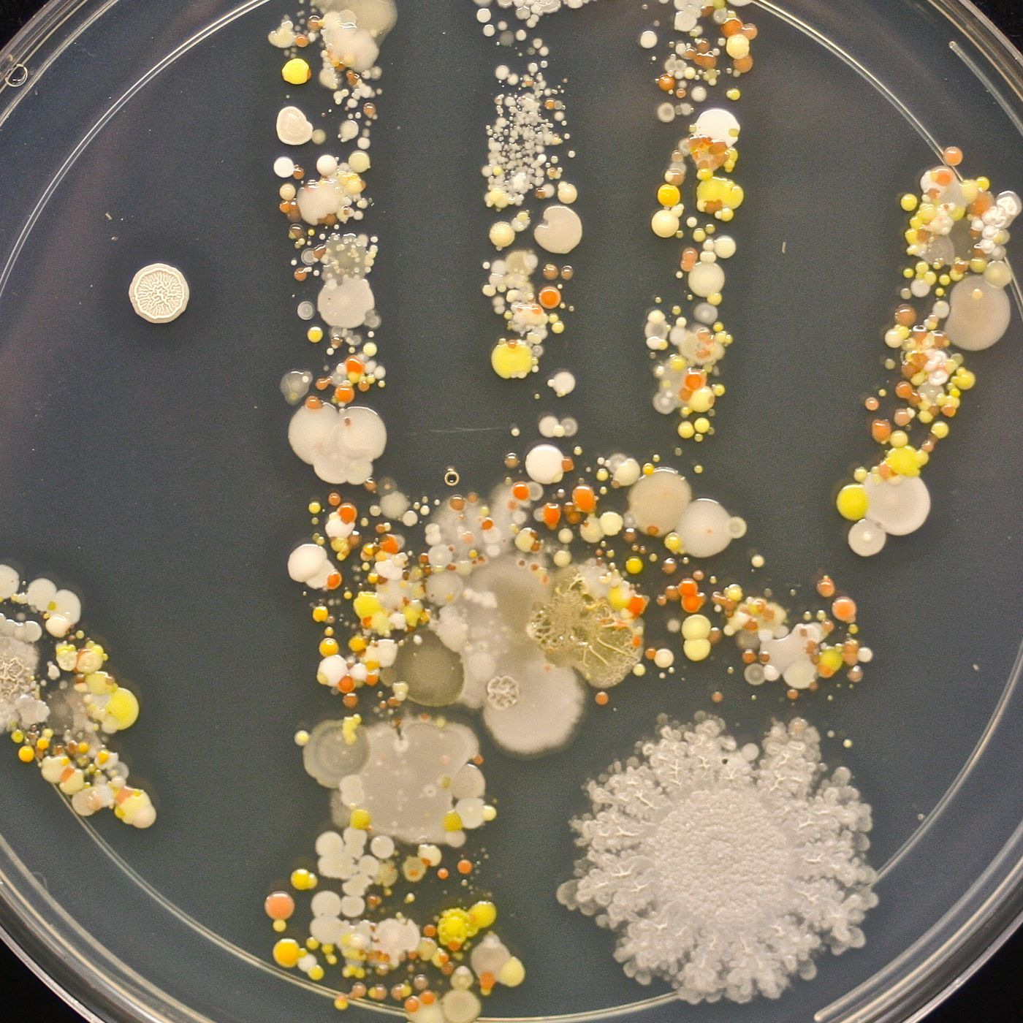
The body can protect itself from infection
The human body has a number of mechanisms to protect it from invading organisms. If the body's defences are overcome, the invaders may cause disease.
Such disease-causing organisms are called pathogens. Some diseases are spread from one person to another.
These diseases are communicable, or infectious, diseases and are also called transmissible diseases. We are often exposed to pathogens without realising it.
Notes:
Teacher Cue – refer to the vocabulary box as you read through and “unpack” the definition provided. Use hand gestures to emphasise the ”2 or more”, “mixed” and “separated” parts of the definition.
Have students complete CFU 1 as a pair-share, then record these definitions & examples as notes (with diagrams) if desired.
CFU 2 – pair-share, then whiteboards for answers – call on non-volunteers.

Slide 3

The body can protect itself from infection
Luckily, our bodies have a number of defences that protect us from them.
Many pathogens are prevented from entering the body or, if they do enter, are dealt with before they can cause symptoms of disease.
Even if we do become the body's defence system often enables recovery without any medical intervention.

Slide 4
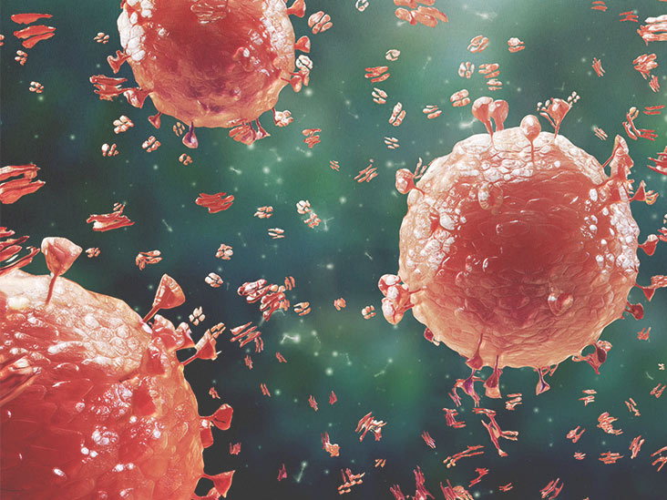
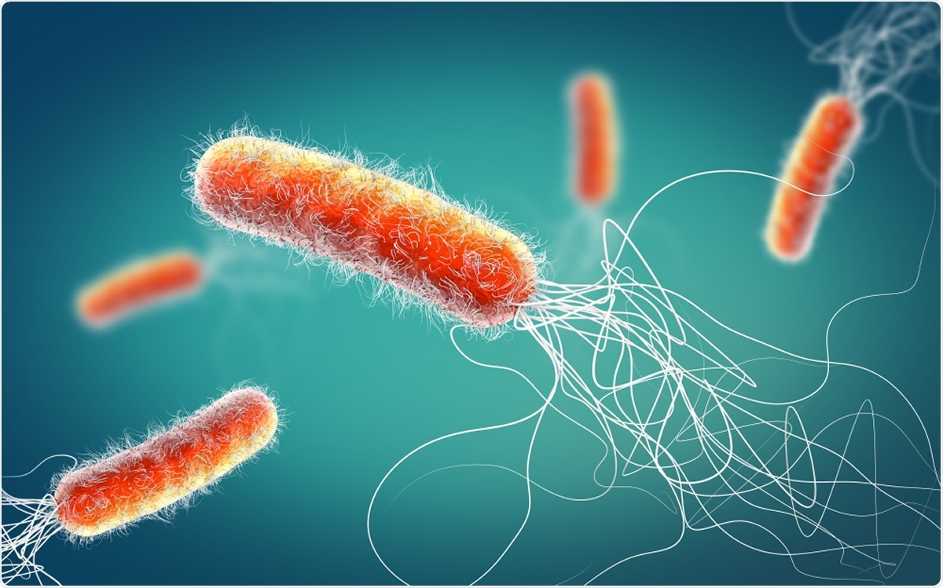
Pathogens
The most common pathogens that affect the human body are bacteria and viruses, although fungi and animal parasites can also be involved. We will be focusing on bacteria and viruses.

Slide 5
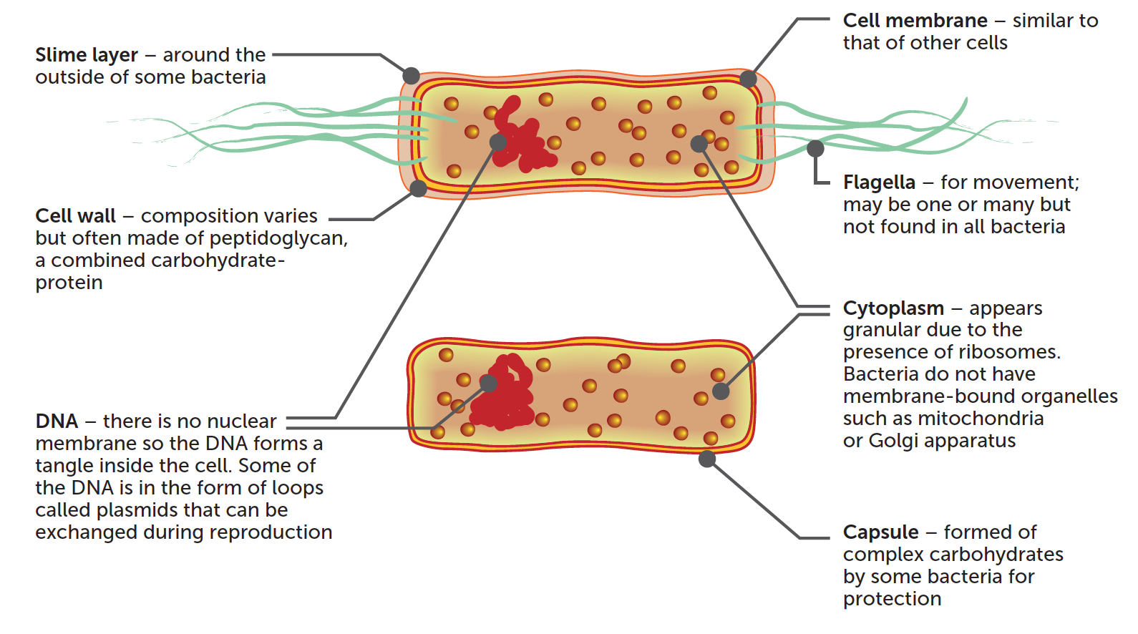
Bacteria
Bacteria are prokaryote, unicellular organisms with a simple internal structure. They lack a nucleus their DNA either floats freely in the cytoplasm or is in the form of circular plasmids.

Slide 6
Bacteria
The great majority of bacteria are harmless to humans; they are non-pathogenic.
Indeed, many bacteria are essential to life on Earth, through their role in the decomposition of organic material and the cycling of the elements.
Some bacteria are used in industrial processes.
For example, Lactobacilli are used to make yoghurt and sauerkraut; and the flavour of cheeses depends on the types of bacteria used in their production.

Slide 7
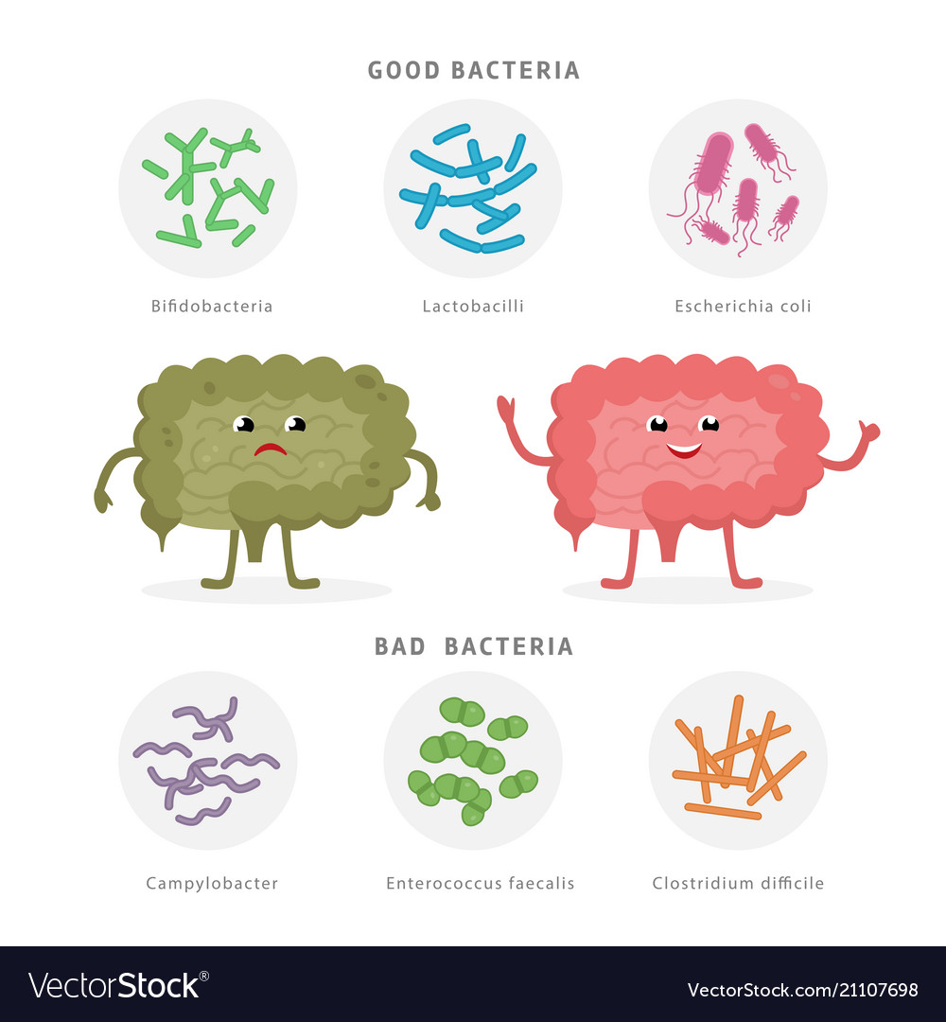
Bacteria
Huge numbers of bacteria live on our skin, in our alimentary canal and in other parts of the body.
In the armpit of an adult male, there are more than two million bacteria per square centimetre skin surface, and in the intestines, bacteria are so numerous that they form a major part of the digestion process.
These bacteria have no ill effect on our health, yet there are others that may cause illness or death when present in relatively small numbers.
Bacteria affect the body differently, depending on the species. Effects may include producing toxins or inducing an allergic response.

Slide 8
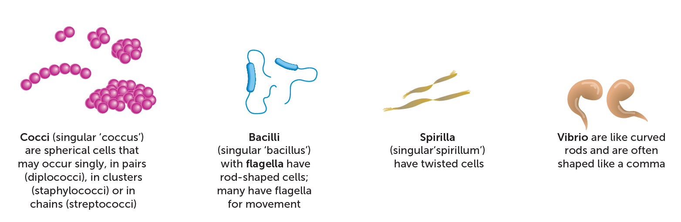
Bacteria are very small, with the average diameter ranging from 0.5 to 2.0 um (micrometres: 1 pm-1x 10 ml and length ranging from 1 to 10 um. This means that bacteria can be seen only with microscope Under the light microscope, about all that can be seen of bacteria is the shape of their cells, which is used to classify them.
To identify a bacterium, it is first grown on an agar plate or growth medium in specific conditions.
Then it can be stained and viewed under a microscope.

Slide 9
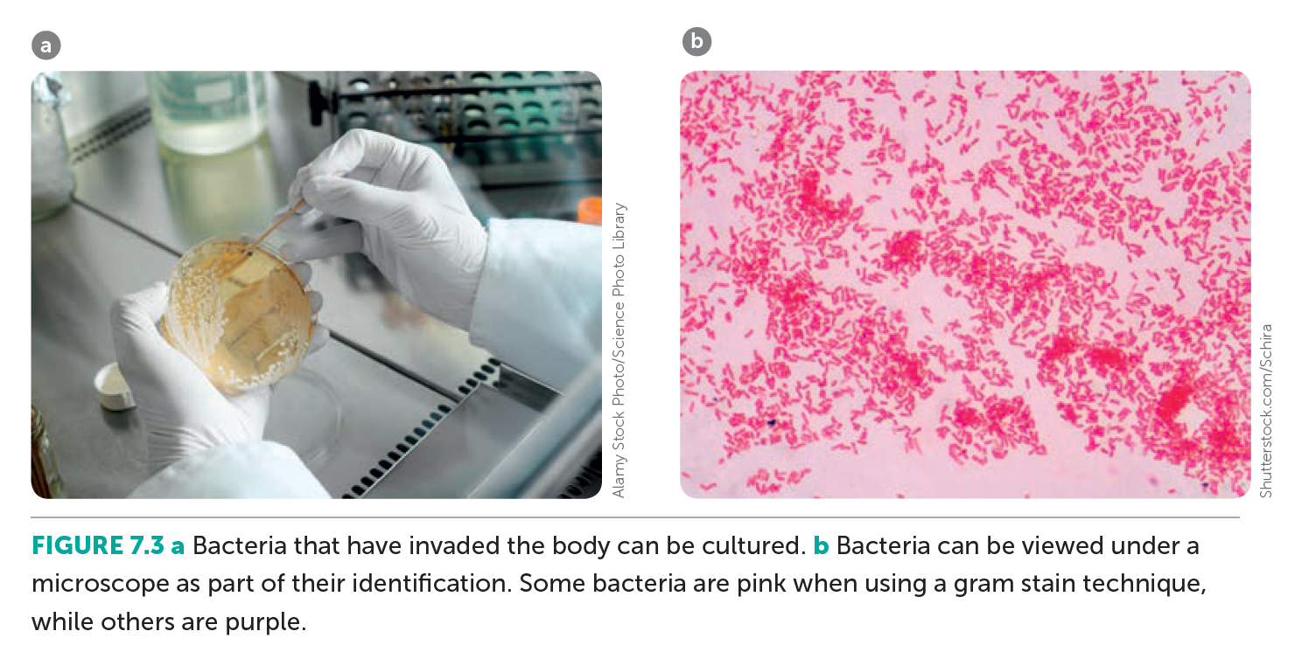

Slide 10
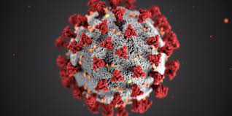
Viruses
The discovery, by scientists such as Pasteur and Koch in the late 19th century, that some diseases were caused by bacteria was a great step forward for medical science. There were, however, certain diseases for which no bacterial cause could be found.
For example, Pasteur tried in vain to find a bacterium that caused the disease rabies. We now know that the causes of these diseases are viruses.

Slide 11
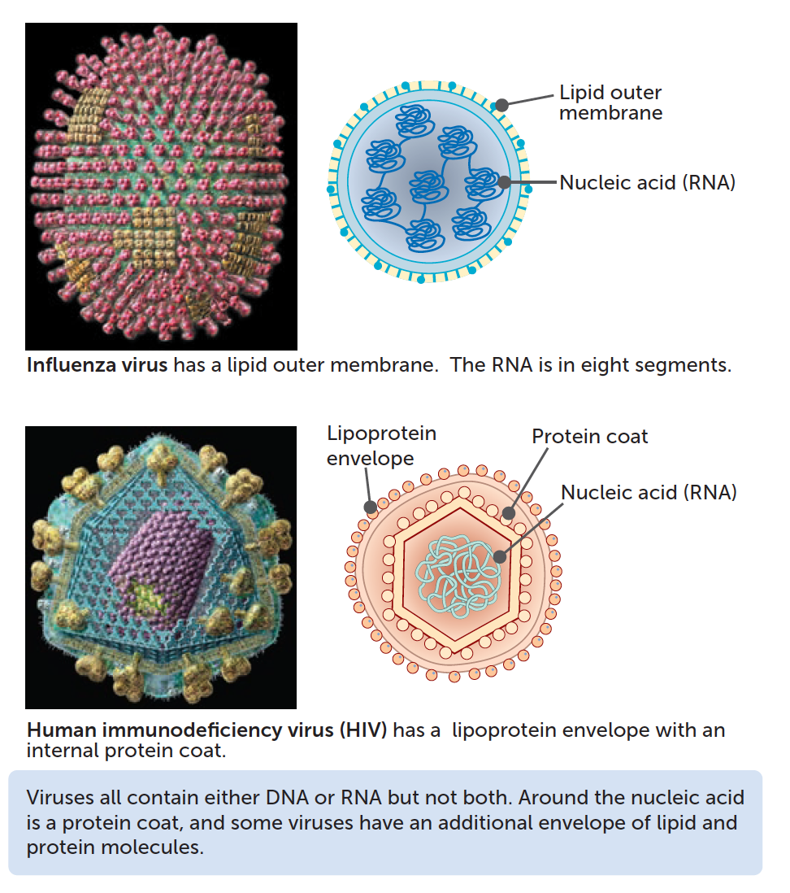
Viruses
Viruses are from 20 to 750nm (nanometres, 1 nm = 1 x 103 m) in size, which is too small to be seen with an ordinary light microscope. It wasn't until 1938 that scientists used an electron microscope to first see viruses.
Subsequent studies showed that viruses had distinctive structures and differing sizes. All were found to contain genetic material in the form of a molecule of either DNA (deoxyribonucleic acid) or RNA (ribonucleic acid), but they never contained both.
The molecule of DNA or RNA is surrounded by a coat of protein. Some viruses also have an external lipid envelope.

Slide 13
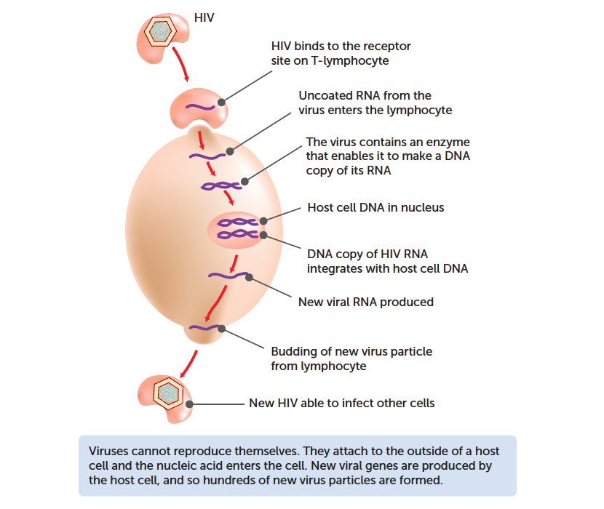
Viruses
Viruses are not living things, as they cannot reproduce by themselves. Instead, they infect a living cell and its DNA or RNA induces the cell to manufacture more virus particles.
The new virus particles are then able to leave the host cell to infect others. During this process the cells become damaged or changed, or die.
Viruses differ in the type of cell they invade; therefore, the symptoms shown relate to the tissue that is affected.
Some viruses multiply in bacterial cells, causing the death of the bacterium. Such viruses are known as bacteriophages.

Slide 15
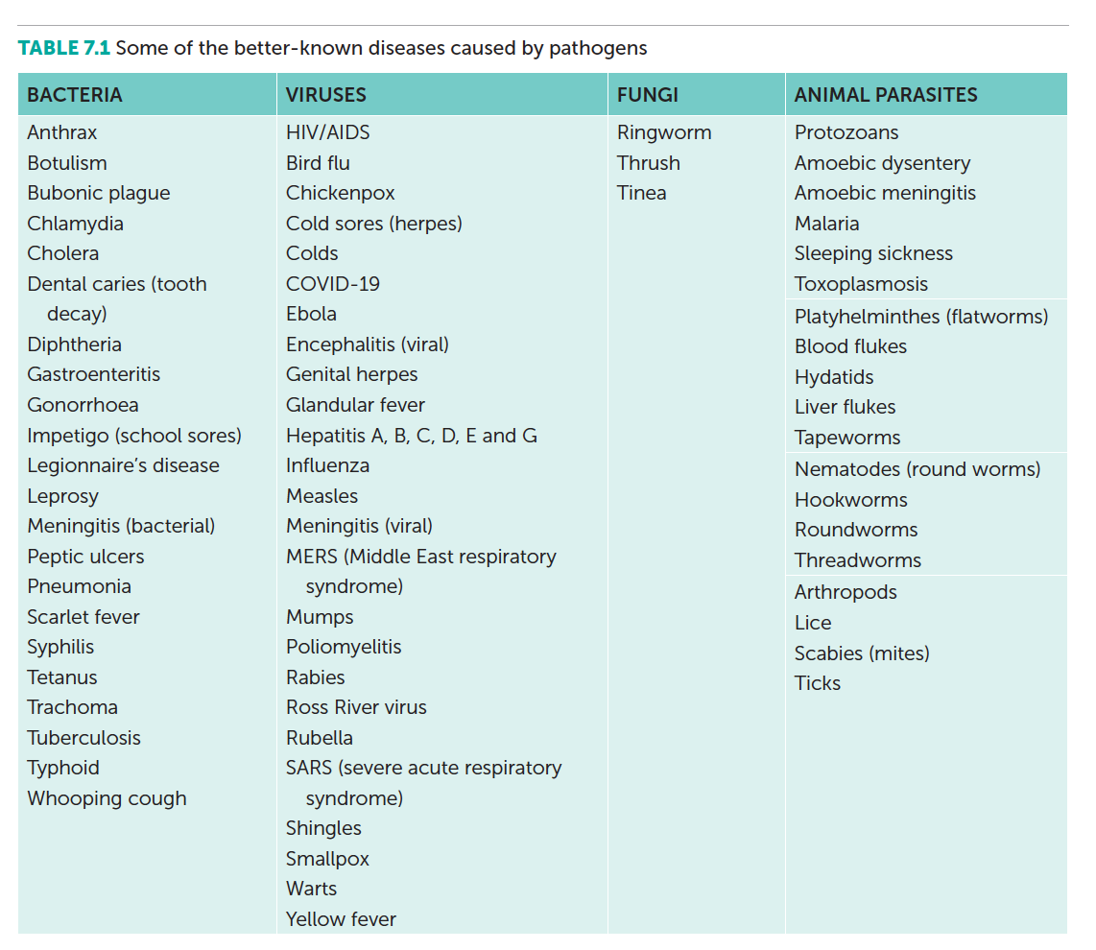

Slide 16
Transmission of pathogens
Communicable disease may be spread by the transmission of the pathogenic organism from one person to another. Some communicable diseases are said to be contagious; this means they are passed directly from one person to another.
Other communicable diseases may be spread from person to person by vectors: Intermediate hosts of the pathogen, such as mosquitoes or fleas.
Transfer can occur in a number of ways:
Infection by droplets
Ingestion of food
Transfer of body fluids
Infection by droplets

Slide 17
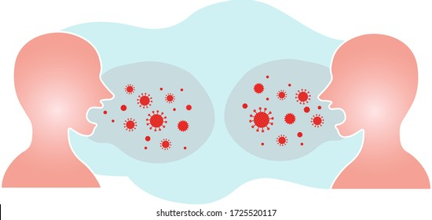
Infection by droplets
Infection by droplets may occur when tiny droplets of moisture containing pathogenic organisms are emitted when breathing, talking, sneezing or coughing.
The droplets may be breathed in by others, or may settle on food or utensils to be later ingested with food.
Many viral infections, such as those causing Ebola, COVID-19, mumps, colds and influenza, can be spread by droplets.

Slide 18
Transfer of body fluids
Transfer of body fluids from one person to another can result in the transmission of a number of infections.
When blood or other body fluids from an infected person comes into contact with the mucous membranes, such as in the nose, mouth, throat and genitals, or the bloodstream of an uninfected person, such as through a needle stick or a break in the skin, then pathogens may enter the body of that person.
The human immunodeficiency virus, and hepatitis B and C, are spread in this way.

Slide 19
Ingestion of food or drink
Ingestion of food or drink contaminated with pathogens may result in disease. Dysentery, typhoid fever and Salmonella food poisoning are transmitted in this way.

Slide 20
Transmission by contact
Transmission by contact involves the spread of the pathogen by actual physical contact.
The contact may be direct, actually touching an infected person; or indirect, touching an object that has been touched by an infected individual.
Skin infections and sexually transmissible infections are spread contact.

Slide 21
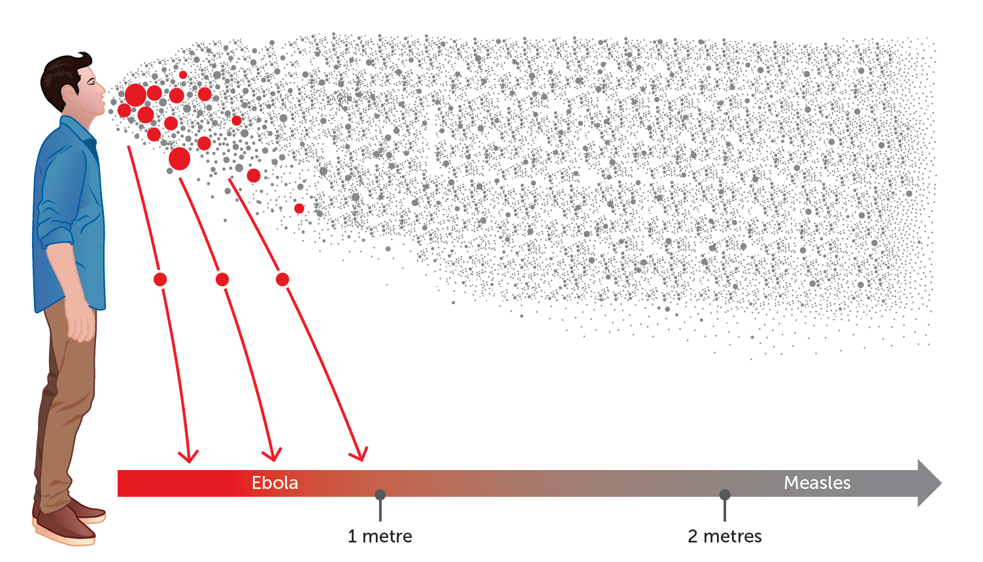
Airborne transmission
Airborne transmission of some diseases may occur. When the moisture in exhaled droplets evaporates, many bacteria are killed, but viruses and some bacteria remain viable and can cause infection when inhaled.
As these particles are lighter, they remain viable for a greater distance than those transmitted by droplets. Measles and chickenpox are spread by this method.

Slide 22
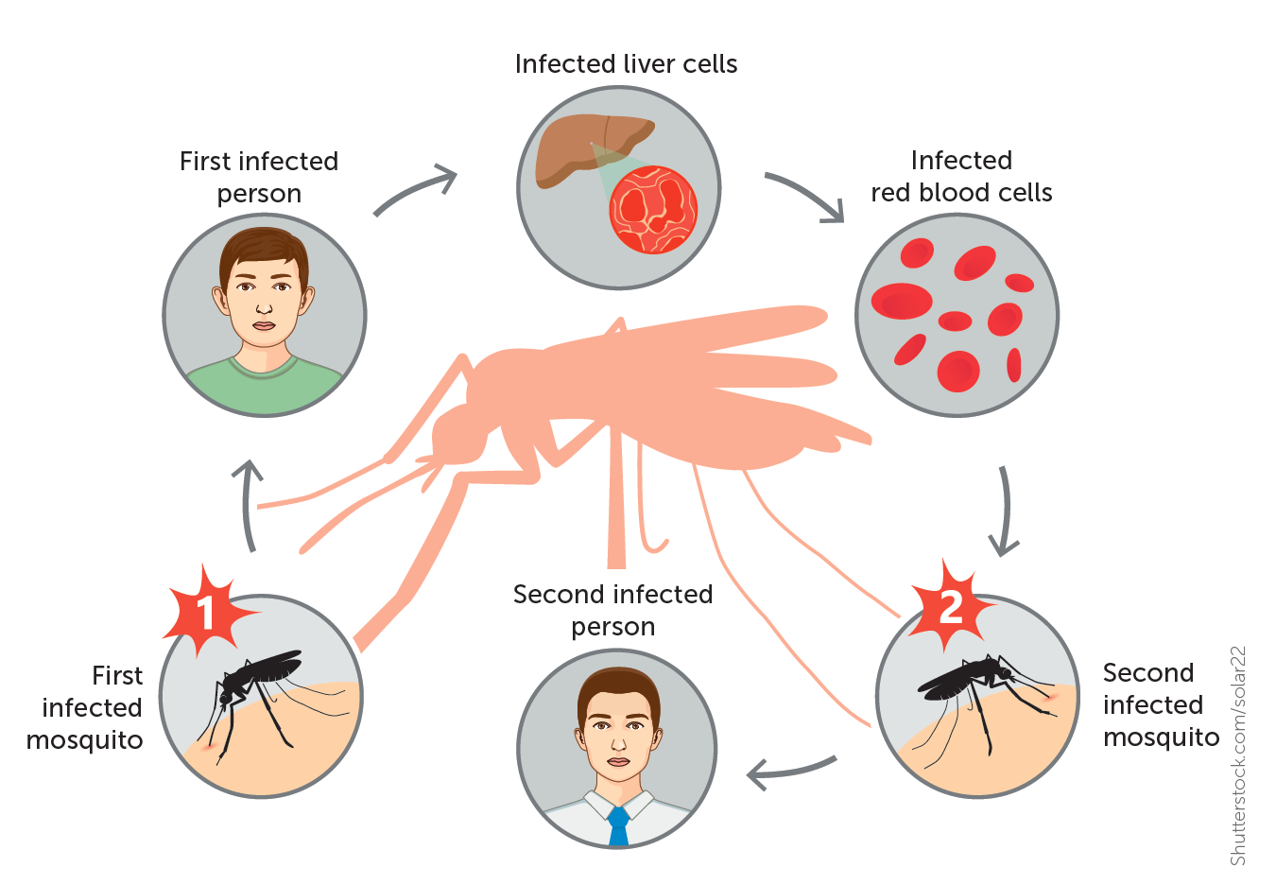
Transmission by vectors
Transmission by vectors is the transfer of pathogens by other animals, such as insects, ticks or mites.
Some vectors transfer the pathogen directly; others, such as house flies, may spread the pathogen to food or water, which is then ingested. Many vector-borne diseases are spread by a specific vector.
For example, malaria and dengue fever are spread by mosquitoes, trypanosomiasis (African sleeping sickness) is spread by the tsetse fly. Lyme disease is spread by ticks, and bubonic plague is spread by fleas from rats and mice.

Slide 23
Summary
Communicable diseases are caused by pathogens such as bacteria and viruses and are spread from person to person, either directly or indirectly.

Slide 24
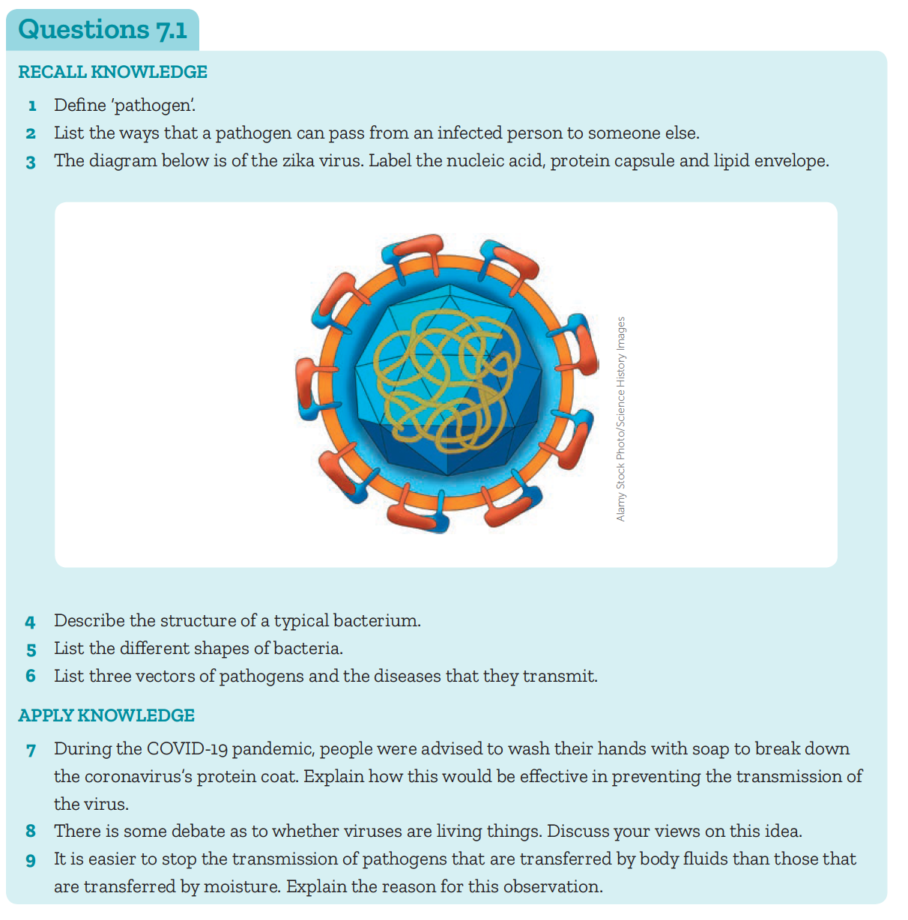

Slide 25
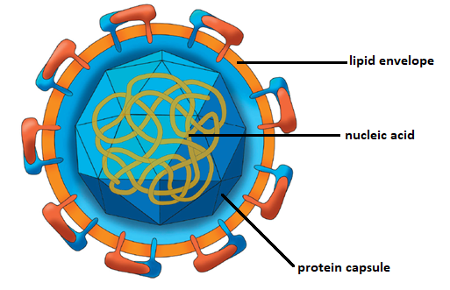
1 Define ‘pathogen’.
Answer: A disease causing organism.
2 List the ways that a pathogen can pass from an infected person to someone else.
Answer: Transfer by contact, ingestion, transfer of body fluids, infection by droplets, airborne transmission, transmission by vectors
3 The diagram below is of the zika virus. Label the nucleic acid, protein capsule and lipid envelope.
Answer:

Slide 26
4 Describe the structure of a typical bacterium.
Answer: Bacterium are unicellular and lack a nucleus, their DNA is either free floating in the cytoplasm or in circular plasmids. Bacteria are microscopic and can be classified according to shape.
5 List the different shapes of bacteria.
Answer: Cocci – round, Bacilli – rod, Spirilla – spiral, Vibrio – curved rod/comma shape.
6 List three vectors of pathogens and the diseases that they transmit.
Answer: Mosquito – malaria or dengue fever, Tsetse fly – trypanosomiasis (African sleeping sickness), Ticks – Lyme disease, Fleas from rats and mice – bubonic plague.

Slide 27
APPLY KNOWLEDGE
7 During the COVID-19 pandemic, people were advised to wash their hands with soap to break down the coronavirus’s protein coat. Explain how this would be effective in preventing the transmission of the virus.
Answer: The soap dissolves the oily surface membrane/fatty membrane, so the virus is destroyed. If the virus is unable to reproduce it cannot be transmitted.
8 There is some debate as to whether viruses are living things. Discuss your views on this idea.
Answer: Student responses will vary as this is an opinion question. To be determined living, many scientists believe that all eight characteristics of life must be fulfilled. Viruses are not able to reproduce without the use of a host cell, nor are they made of cells which are two characteristics of life.
9 It is easier to stop the transmission of pathogens that are transferred by body fluids than those that are transferred by moisture. Explain the reason for this observation.
Answer: Transmission by body fluids can be prevented using a condom or dental dam during sexual intercourse. Not sharing needles with anyone will prevent the spreading of pathogens from the bloodstream. Transmission by moisture is harder to prevent as droplets containing the pathogenic organism may be inhaled or may settle on food or utensils to later be ingested with food.

